Slide 1
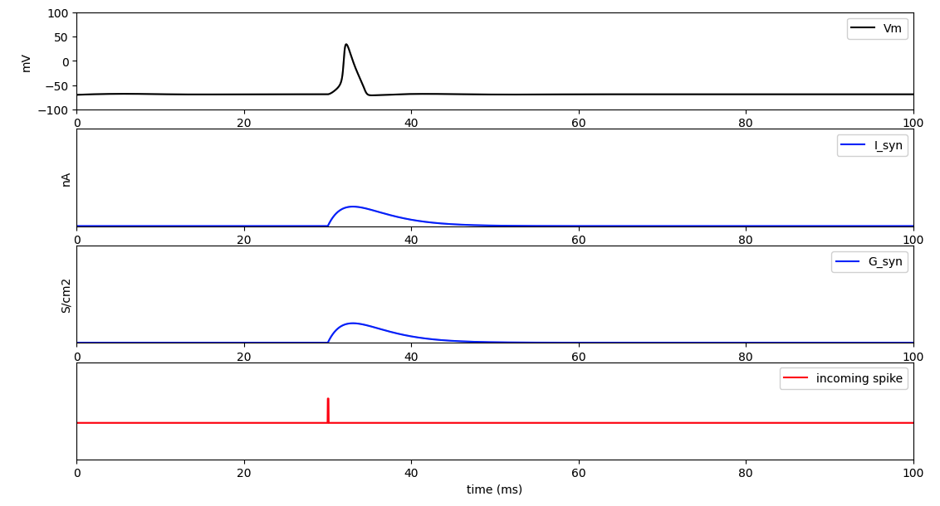
Synapses Excitation
The presynaptic neuron releases neurotransmitters in response to an incoming spike. This release causes the synapse channels of the postsynaptic neuron to open. As a result, the synapse's conductance and current increase. Subsequently, this increased activity leads to the generation of a spike.

